Slide 1
Design Process
MPQA Quality Alliance Training Module Series
Presenter: Name
Role
Company
Notes:
Hello! Welcome to the MPQA Quality Alliance Training Module series. The MPQA Quality Alliance is a sub-committee of the Montana Photonics and Quantum Alliance in Bozeman, Montana. Our mission is to provide helpful tools for implementing Quality Management Systems. This presentation is one of series of training modules designed to assist organization with implementing processes as solution to common manufacturing problems.
This presentation provides a framework for implementing a Design Process in your organization. The Design Process is an essential solution for organizing design projects in your organization.

Slide 2




Agenda: This is what you will learn
What is a Design Process?
Why implement a Design Process?
How do I implement a Design Process?
How does a Design Process improve the organization?
Notes:
In this presentation you’ll learn
What a Design Process is
Why it is so valuable to implement a Design Process
A few easy steps for how to implement this process in your organization.
How the Design Process leads to improving your organization

Slide 3
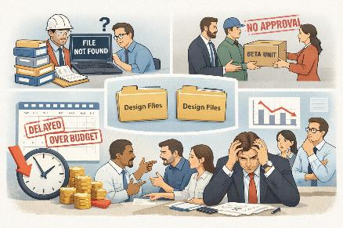
Problem Statement
Problem: Multiple design projects are in process and opportunities seem endless, but engineering resources are stressed.
Engineers can’t find the information and specs for the project.
Each engineer creates their own folder structure and file location, and the locations aren’t shared.
Sales shipped a beta unit to a customer without proper approvals.
Various engineering disciplines aren’t on the same page about the design.
Engineers, management, and other stake holders aren’t aligned.
Design projects aren’t meeting schedules, budget, or specification.
Solution: Implement a Design Process
Notes:
Do these challenges sound familiar? Many organizations face them!
Missed schedules, budget overruns, and designs that don’t fully meet specifications.
Files are not stored consistently; the disorganization makes critical data hard to find and leads to misalignment between teams.
In some cases, prototypes may even reach a customer expecting finished product.
The solution to these challenges is a structured design process.
By defining how projects are organized, reviewed, and controlled, the design process creates alignment across disciplines, improves communication, eases data/record finding, and reduces risk throughout the project lifecycle.

Slide 4

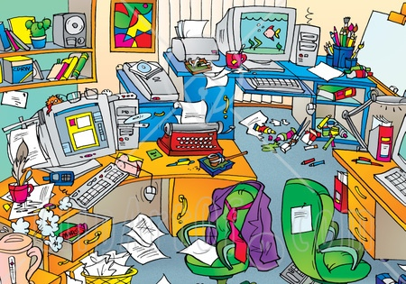
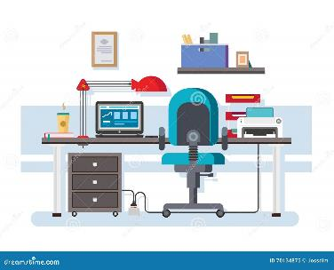
What is a Design Process?
The Design Process is a methodical, disciplined approach for ensuring product designs are completed successfully through team alignment and organization.
Organize
Everything everywhere
Everything in its place
Notes:
A design process is a disciplined, methodical approach to completing product designs successfully.
Its primary purpose is to align teams and organize information so that everyone is working toward the same goal and everyone is clear on what that goal is.
Instead of a free-for-all with every engineer marching to the beat of their own drum, the design process ensures the entire team is working in concert, focused on the same priorities, on the same schedule.
The design process is the method for giving structure to your R&D team.

Slide 5
Design Process
Part of the New Product Introduction Process (NPI)
Market Analysis
Determine feasibility
Determine budget
Opportunity to design new product, assemblies, redesigns
This training module focuses on the Design Process portion of the NPI Process.
Design Process
Organize the design project
Establish design stages
Ensure manufacturing readiness
Lock down initial offering
  Completed product that meets specification (final product, assemblies, etc.)
  Documentation that supports product (drawings, work instructions, etc)
Release to Production
Notes:
The design process is a core part of the overall New Product Introduction, or NPI, process.
NPI begins with market analysis and feasibility, flows through design, and ends with release to production.
This training focuses specifically on the design portion—where the project is organized, design stages are established, and products are prototyped, all driving towards a final product that can be released to production.

Slide 6

Why Implement A Design Process?
Risk Mitigation:
Prevents the risk of missing key design steps to ensure the design stays on schedule, meets budget
Prevents the risk of designs not meeting customer requirements.
Organizes information and data:
Ensures information and data are organized in common folder structure.
Organizing a design project through a simple process improves the efficiency of the design process and frees up resources to perform the key function of creating design solutions.
Spend more time on fun designs and less time trying to organize.
Notes:
By defining how projects are organized, reviewed, and controlled, the design process helps project managers keep design projects on schedule and within budget while ensuring customer requirements are met.
It organizes information into a common structure, freeing engineers to spend more time designing and less time searching for files or recreating work.
Ultimately, it creates alignment across disciplines, improves communication, eases data/record finding, and reduces risk throughout the project lifecycle.

Slide 7
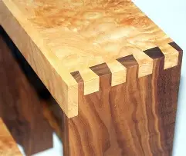
Design Process Elements
This process is unique in that it doesn’t happen in strict sequence.
Instead, these are essential process elements of a design project that are interwoven, interdependent.
The New Product Introduction (NPI) process provides the framework for a sequential process and dovetails with the Design Project.
For the purposes of this training module, it is assumed the tasks and decisions necessary to begin the design project have been completed.
The next series of slides explores each of these process elements.
  Planning
  Design Inputs
  Design Analysis
  Design Outputs
  Verification
  Reviews
  Validation
  Change Control
Design
NPI
Not a sequential step-by-step process;
a collection of elements to organize the design project
Notes:
The design process is unique in that it is not a step-by-step sequential process. It’s a collection of elements that ensure the design is organized and ultimately satisfies design and customer requirements.
The New Product Introduction (NPI) process provides a structure that guides the design through a sequence of phases that ensures key design elements are performed at the appropriate times.
These are the common elements to a basic design process:
Planning ensures there is a budget and a timeline, identifies the team with a project lead, ensures risks are identified and tracked and ensures there are plans for verification and validation.
Design inputs include product specifications and requirements that are critical to meeting customer needs as well as regulatory or statutory requirements.
Design Analysis is the heart of the design project where experiments are performed and data is analyzed to determine whether the product design is capable of meeting specifications.
Design outputs ensures that documentation supporting the design are captured such as drawings, work instructions, product specifications, and data sheets. This documentation is invaluable to production and scalability.
Design reviews are meetings where the design team reviews the design, make improvements, determines the status of the project, determine next steps, identifies roadblocks, and organizes resources to remove these roadblocks.
Verification is the methodical process for ensuring the design meets the specifications.
Validation is the process for ensuring the design meets the intended use or application. This may be done in a coordinated effort with a customer.
Change Control ensures that as the design evolves, the changes are carefully controlled to understand and manage risk associate with changes. This is particularly important if the design inputs are changed.
The next few slides goes into each of these design elements in greater detail.

Slide 8
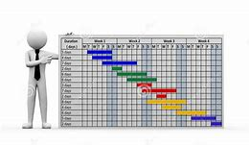
Planning
Planning ensures the key elements of the project are defined. This includes creating a schedule, establishing a budget, identifying a team, and ensuring verification and validation activities are planned.
Allocate a Budget
Create a Schedule
Conduct Risk Analysis
Assign Project Lead
Determine Project Team
Establish a Verification Plan
Coordinate a Validation Plan
What is the plan for completing the design project?
Notes:
Planning defines how the design project will be completed. This includes establishing a budget and schedule, assigning a project lead and team, conducting risk analysis, and coordinating verification and validation plans. Good planning ensures expectations are clear before detailed design work begins.
Planning might include a Gant chart for organizing a schedule.
Risk matrix is often employed to record and track project risks to ensure they are mitigated as they pop up throughout the project.
The project lead plays a key role in overseeing the project and ensuring it stays within budget and on schedule and that the design plan if maintained all the way through validation. The Project Lead also ensures design reviews are happening regularly to keep the team focused and effective.
Planning ensures that a cross-functional team is organized with well-defined roles and responsibilities. This team may include personnel from manufacturing, such as MFE’s and materials personnel such as buyers and planners.

Slide 9

Reviews
Design Reviews – the process of evaluating the ability of the design to meet functional and physical requirements and to identify and resolve problems that arise.
Example of types of reviews
Review schedule, cost, and risks.
Review design progress, problems.
Review design analysis.
Generally, in presentation form.
Capture record of attendance.
Include multiple design disciplines.
Capture action items.
Coordinate resources.
Reviews | TLA
System Requirements Review | SRR
System Architecture Review | SAR
Preliminary Design Review | PDR
Critical Design Review | CDR
Production Readiness Review | PRR
What is the status of the project?
Notes:
Design reviews provide regular checkpoints for evaluating project status, risks, and progress. These reviews typically involve multiple disciplines, are often presented formally, and include documented attendance and action items. Reviews help ensure risks are identified early and resources stay aligned and focused.
Reviews serve as a record of progress as the project evolves.
There are many types of design reviews each with it’s own purpose. The different types of reviews are employed at various stages as the design progresses through the NPI process.
These records may be useful later even during manufacturing or to assist with answering questions from customers.

Slide 10

Design Inputs
Inputs – define the product requirements and characteristics that guides the direction and scope of the design.
Product Requirements (Primarily driven by customer needs).
Engineering Functional requirements.
Design Specifications – complete set of specifications for every aspect of the design.
Lessons learned from previous designs.
Statutory and regulatory requirements.
  Export Control.
  Safety.
  Environmental.
Competitor Information.
Supplier capabilities.
What are the design/product requirements?
Notes:
Design inputs define the specifications, performance characteristics, requirements and everything necessary to provide the framework of the design.
Design specifications are defined to ensure that the product performance meets requirements.
This is where lessons learned from previous designs may be applied.
Statutory and regulatory requirements are essential inputs to ensure proper export controls are in place, safety concerns are addressed, and that the environment is not negatively impacted.

Slide 11
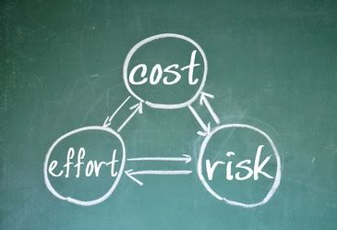
Design Analysis
Design Analysis – This is the heart of design and provides insight regarding the product’s ability to meet specifications.
Design rationale and decisions.
Material selection.
Calculations and computational spreadsheets.
Technical data analysis from experiments and tests.
Trade studies.
80%
16%
4%
Document All, Focus on High-Risk Items
Notes:
Design and material selection decisions and rationale should be documented for review and future reference. This process helps to ensure that all of the specifications will be met and that future changes do not inadvertently degrade performance.
Calculations, experiments, and test are performed to ensure product specifications will be met. To control costs and schedule follow the 80:16:4 rule. In most applications 80% of the design is low risk, based on standard, proven designs and/or have large margins. These require relatively low efforts to ensure product specifications are met. Of the remaining 20%, 80% (16% of total) needs a moderate level of analysis and 20% (last 4% of total) represents the highest risk area which should get 80% of the effort.

Slide 12
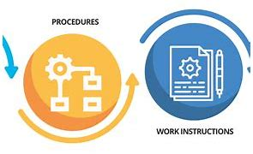
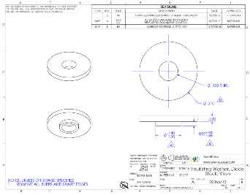
Outputs
Design Outputs – documentation essential to ensure the product can be properly manufactured as designed
Drawing, schematics, bill of materials, PCB files.
Work instructions.
Inspection and Testing plans.
Manufacturing plans.
Supplier and purchasing information.
Final Specification Document.
Data sheet.
Do we have what we need to build this?
Notes:
The design outputs ensure that the as the design finalizes key elements of the design are defined, documented, and stored.
Design outputs include the drawings, schematics, bill of materials and PCB files all of which are critical to reproducing the various materials that compose the product. These are used for suppliers to manufacture the product and for internal assembly.
Work instructions for how to assemble the material is critical to ensure technicians responsible for building the product are building it as engineers had intended.
Manufacturing plans ensure there is adequate space for storing volumes of material and that there is adequate production space and equipment for building the product. Manufacturing plans ensure that packaging and labeling requirements are determined.
Design outputs include a final formal Specification document that is complete and controlled.
Design outputs also include a final data sheet that can be shared with current and potential customers.
The documentation should be complete and provide adequate information to allow an independent party to produce the product.

Slide 13
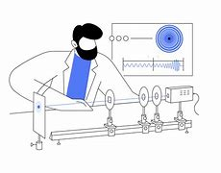
Verification
Verification – testing that ensures physical and functional attributes of a product design are measured, tested, and compared to design input specifications to ensure conformance to customer requirements.
Create a matrix with each of the specifications defined in the specifications document.
Determine how each specification will be verified (by design, calculation, direct measurement, etc.).
Perform calculations and/or testing and capture record of results.
Does the design meet spec?
Notes:
Verification is the methodical process confirming the design meets specifications defined in the Design Inputs phase. Each requirement is mapped to a verification method, such as measurement or testing, and results are documented. Verification focuses on ensuring the product conforms to defined requirements.
A common approach is to create a matrix listing all of the design specifications and the methods by which the specifications will be verified. In addition to direct measurements some parameters such as the wavelength of a laser are verified “by design” in that the wavelength is determined by the energy levels in the host material. Other parameters can be verified by calculation using fundamental properties or measured parameters.
Data is collected, analyzed to determine whether specifications are met. Sometimes the results of verification help shape the specifications through an iterative process.
Once the specifications are dialed in and there is sufficient data that demonstrates the specifications can be met, then the design project can proceed with finalizing design outputs.

Slide 14

Validation
Validation – product design testing in a setting that ensures that it meets the customer’s intended use, application, and expectations.
Reliability development tests or life tests.
Environmental tests.
Software validation.
Risk and hazards analysis.
Failure modes and effects analysis.
Durability or certification tests.
May include beta testing with the customer/end user.
Does the product work for the customer?
Notes:
Validation is the process for ensuring that the product performs as the customer intended and meets their expectations for quality, reliability, and user interface.
While a design may meet all of the specifications through verification process, design validation ensures that it performs as expected in real-world scenarios and applications. Validation ensures that the total user experience, i.e. packaging, setup, start up and use, is positive.
Design validation may be performed externally by the customer. Customer feedback is often the “data” that concludes the design validation step.

Slide 15



Example: Verification vs Validation
Imagine your team is designing a dishwasher.
Verification
Validation
Engineering Perspective:
Does it meet specifications?
Customer Perspective:
Does it work as intended?
Does the unit meet expectations?
Does the water arm spin?
Does the heating element reach temperature?
Does the water pump bring adequate volumes?
Do the buttons work?
Are the dishes clean?
Are the dishes broken?
Is the unit quiet?
Do buttons have a quality feel?
Do you get soaked when you open the door?
Notes:
Verification and validation are often confused. The dishwasher example is a useful analogy to assist with distinguishing these very different steps.
Verification answers the question; does the design meet specifications:
Does the water arm spin smoothly?
Does the heating element reach the expected and desired temperature?
Does the water pump bring adequate volumes of water onto the dishes?
Do the buttons work to ensure the various functions are initiated?
Validation answers the question; does it meet customer expectations:
Does it work as intended?
Are the dishes clean?
Did any of the dishes get broken during the application?
Is the unit quiet?
Do the buttons have a quality feel?
Did you get soaked while opening the dishwasher door?

Slide 16

Change Control
Design Changes – The process for controlling changes to the design methodically.
Changes to the design should be done in a controlled, simple manner that maintains fluidity.
Changes to design inputs should be formally approved as this may have huge impact to schedule, cost, or feasibility.
  Prevent unintentional feature creep and be aware of impact.
Control your changes or sink!
Notes:
There are many changes that take place during the design project. They key is ensure that the design changes are controlled. The level of control is depended on the level of the change.
Design changes – the design will evolve over time with countless iterations. Monitoring and approving the design changes and capturing them in some form, such as updated drawings, is critical. The goal is to streamline this iterative process so that it doesn’t slow down progress. But it needs to be balanced with careful control so the current status is organized and clear.
Changes to design inputs, such as product specifications and requirements can have major impacts to budget, schedule, and even feasibility. This requires significantly more control, with formal approvals. These controls prevent “scope creep” that push a design beyond its initial intent or vision.

Slide 17
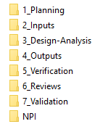
Design Process Folder Structure
Create the folder structure illustrated below for Design Projects and save it as a Template.
When new projects are started, copy the Project Template and save it with a common filename format This ensures that each project is consistently organized to ensure efficient access to data and information about the project.
Store all projects in a centralized location organized by project name.
Notes:
When a project is shared amongst many departments or stakeholders, staying up to date on changing information is critical. Waiting for the next meeting for updates can delay progress or even worse, have team members working off different datasets, wasting effort and time.
We recommend a common folder structure, so team members learn where to find data for any project. This shows a structure based on the elements previously discussed. If the structure is followed consistently, data sharing will become second nature for all stakeholders.
We assume that only the project manager (or their delegate) has Write access to the folders and that other stakeholders only have Read access. It is critical to augment this structure with a robust Document Control System.

Slide 18

How To Implement A Design Process
Create a structured project folder
(standardized for all projects)
Original Design Inputs
Create a project plan
Changes to Design Inputs
Budget
Schedule
Risk Analysis
Project Lead
Project Team
Verification Plan
Validation Plan
Hold Regular Design Review Meetings
Document your actions & changes
Track Tasks to Schedule and Budget
(These tasks become your design analysis, outputs, verification & validation)
Use simple tools and apps.
Notes:
Communication is key when a product/service/system is being designed. Changes to electronics can affect mechanical design parameters. Changes to firmware can affect electronic hardware. Changes in the market can force modifications to the design goals. By default, this is a dynamic time.
First, setting expectations for where to find information is critical. Once trained to expect a particular file structure, team members can efficiently find the data they need for their decision making.
Once the project plan is created, regular review meetings that end with well-defined action items, risk factors, and timelines for individuals will ensure the effort is coordinated and the project moves forward instead of stalling out. High risk items should be addressed first, so if they cannot be overcome, that is known as quickly as possible. When team members are tasked with competing priorities, these should be discussed so timelines reflect reality instead of wishful thinking. Changes to the project plan, design goals, test results, etc. should be documented after each meeting. Having snapshots of the current progress can be invaluable for project post-mortem evaluations.
Task tracking can be done in a simple spreadsheet or Gantt chart. Other project management software is available but can take more time to maintain. Finding the minimum effective system can take a few projects but is well worth the effort.

Slide 19

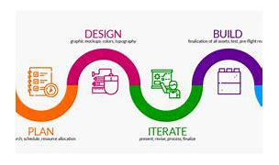
How does a Design Process improve the organization?
Ensures consistency in design projects.
Manages design projects to meet schedules and budgets.
Ensures product design meets requirements.
Organizes engineering resources.
Mitigates project risks.
Become a legend!
Notes:
In technical businesses, innovation is a company’s lifeblood. What was good enough last year may have new competition and not solve enough problems today. Efficiently developing and releasing new products uses engineering resources effectively. Without a Design Process, projects can go off the rails, solving the wrong problems or taking longer than expected, using more resources than were budgeted. [Yes, we speak from experience!]
A Design Process ensures that the deliverable meets the requirements from the customer, that it is done as quickly as possible, and risks are consciously addressed at the beginning of the project.
With a well-coordinated team, development can flow as smoothly as the laws of physics will allow.

Slide 20
Summary: This is what you learned
Organize: The Design Process is a disciplined approach to organizing design projects.
Process: A Design Process ensures products meet customer requirements.
Basic Tools: A Design Process is easy to implement with basic tools and simple software.
Resources: A Design Process helps organize and utilize resources efficiently.
Product design that meets customer expectations!
Notes:
You learned the following gems of knowledge:
The design process is non-sequential process that provides a disciplined approach to organizing design projects.
A design process ensures that the design meets customer requirements, budgetary constraints, and project schedules.
A design process can be implemented with basic tools likely already at your disposal.
The design process helps organize and utilize resources efficiently, keeping the team focused on product success.

Slide 21
Contact Information
For additional resources and information about the MPQA Quality Alliance, visit our website.
MPQA Website
https://www.mpqa.org/
MPQA Quality Alliance
https://www.mpqa.org/quality-alliance/
Notes:
I hope you’ve found this training module useful and that it provides a helpful framework for implementing a Design Process in your organization.
For more information about this process and other processes, access our library for example templates, tools, and ideas, and other training modules, visit our website at www.MPQA.Org
You are welcome to reach out to any of the members of the MPQA Quality Alliance for additional questions.
Thank you!

