Slide 1
WHERE TO START Your Quality Management System (QMS)
Presented by Kurt Borge
Quality Time Montana, LLC
QTM@Q.COM

Slide 2
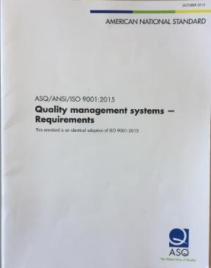
In previous webinars, we looked at using ISO 9001 as a checklist for your QMS
Design
Manufacturing
Document Control
Engineering Change
Equipment Management
Discrepant Material Control
Customer Services
Supplier Management
Training
Problem Solving
System Monitoring

Slide 3

Where do you start?

Slide 4
This is what you will learn
How to use the “Bottom-Up” approach to define your QMS
How to use Flow Charts to develop and improve your QMS
How to compare your QMS against QMS requirements, such as ISO 9001
Additional tips for implementing a QMS

Slide 5

Traditional approach: Top-Down
Begins with a focus on QMS requirements, then writing procedures to address those requirements.
However, the procedures tend to look like the QMS requirements, not actual work processes.

Slide 6

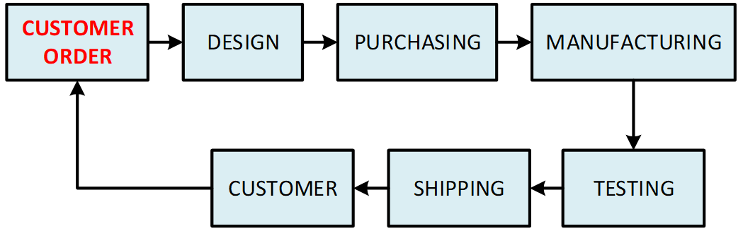
Instead, think: “We already have a QMS…
Since a QMS manages the flow of work and information—from customer order to shipping—start by defining your existing work flow.

Slide 7
The “Bottom-Up” approach
Provides a QMS more relevant to your organization
Easier to implement
People have ownership of the QMS and buy into it.

Slide 8

Using Flow Charts to develop and improve your QMS
Flow charts show the flow of work and information at a management level.
Flow charts help identify risks and opportunities for improvement.
Flow charts make it easier to identify gaps with the QMS requirements.

Slide 9
Other advantages of flow charts
Facilitate group understanding and consensus.
The flow-charting exercise may be more useful that the flow chart itself.
Useful for training and QMS audits.
ISO 9001 and other QMS standards imply using flow charts.
Notes:
* Big benefit. Common for management not to understand what goes on in various departments.
Each company has unique processes. This presentation shows examples of process flowcharting, which are not intended to be implemented as your own processes.

Slide 10




Identify your management tools
Written procedures
Forms, spreadsheets, checklists, reports, and web sites.
Software applications (e.g. Material Resource Planning)
Training programs
Other processes not defined.

Slide 11
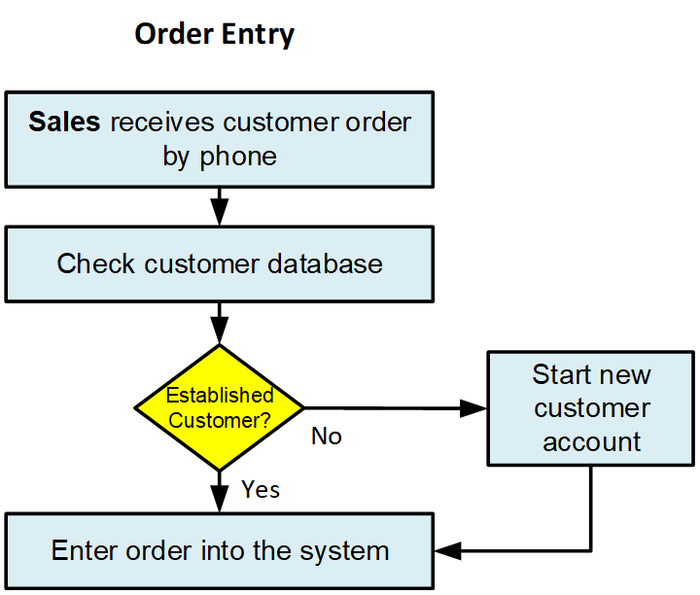
Building a flow chart
Boxes show process inputs, outputs, and basic work tasks
Responsibilities in bold
Arrows show the flow of work and information
Diamonds show decision points and process gates

Slide 12
Example 1: white boarding a Concept Development process
ABC, Inc. is small company, but growing fast.
Recognized the need to get better organized, and decided that a QMS was the solution.
Managers gathered and white-boarded a successful project.

Slide 13
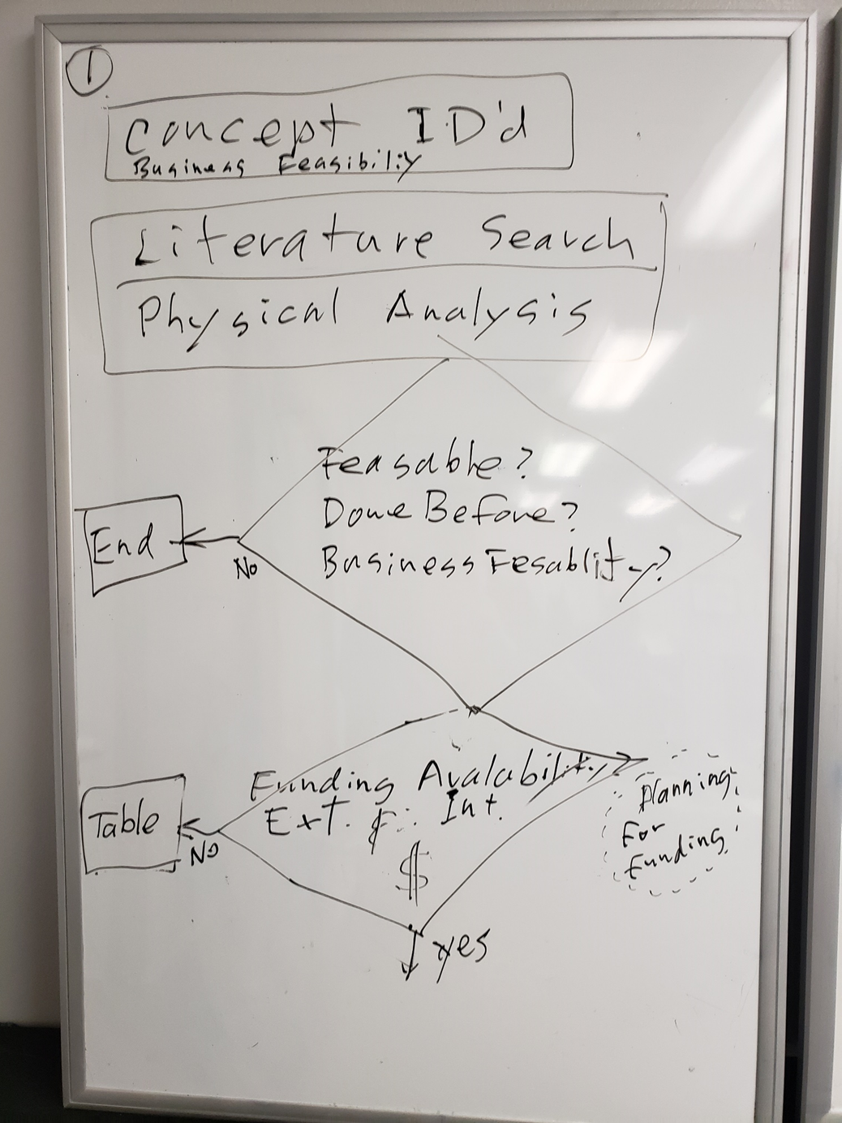

Slide 14
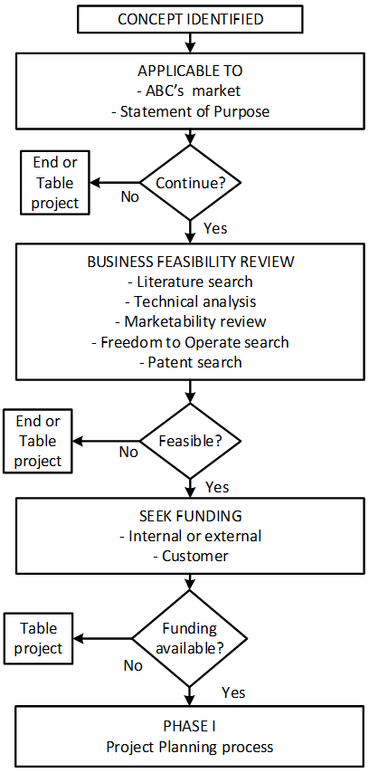

Slide 15
Software was the solution
ABC selected Project Management Software (Jira) as their management tool.
Flow charts were used to configure Jira.
Jira was also used to manage:
  design process
  supplier qualification and monitoring
  resource and information management
  corrective action.
Excel was selected for document control.

Slide 16
Example 2: you don’t always have to start with a flow chart
Machine shop’s processes were minimally documented.
Owner tired of being interrupted by many questions and re-training workers.
They started with detailed procedures.
Flow charting became second phase.

Slide 17
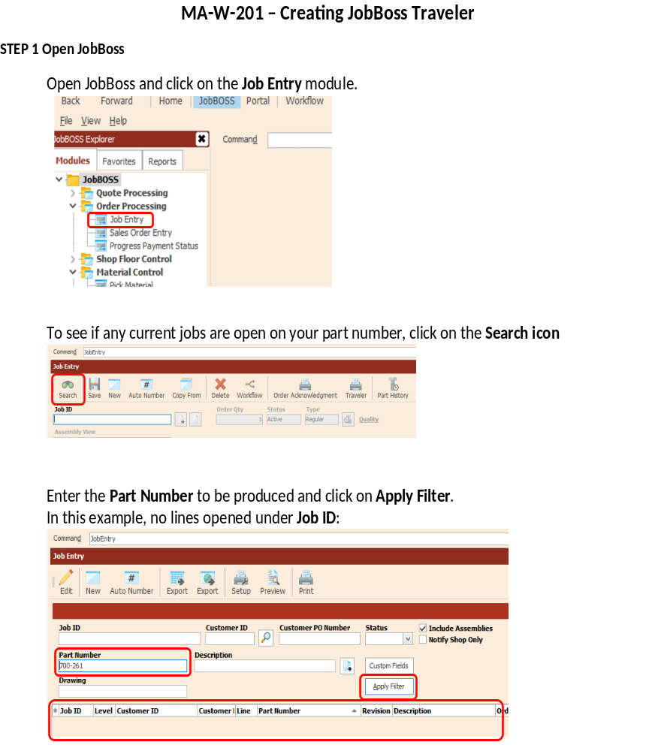
Procedures were written for using their Material Resource Program (JobBoss).
Screen shots were used to show which fields to use and which buttons to click.

Slide 18
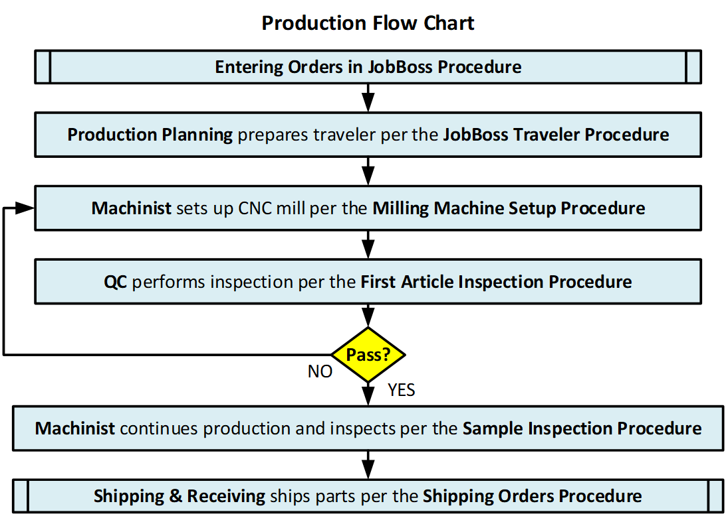
The procedures were then tied together.

Slide 19
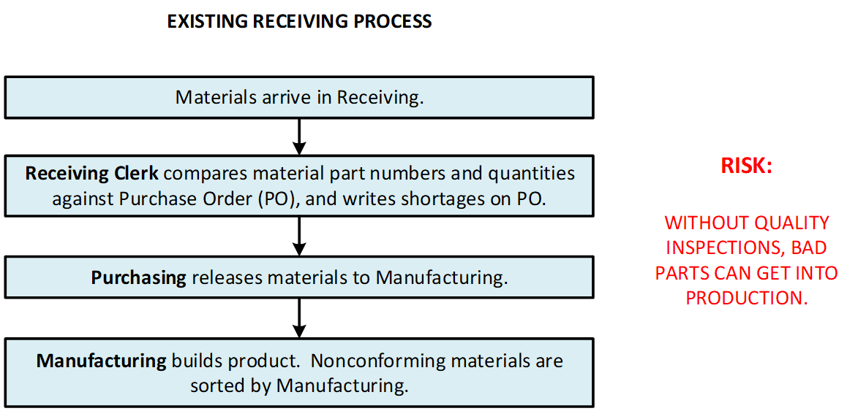
Example 3: Receiving Process

Slide 20
Receiving process was reviewed by:
  Process owner (Receiving)
  Those providing inputs, (Engineering & Purchasing)
  Those receiving outputs (Manufacturing).
The group looked for risks and improvements: where errors might occur, pain points, and inefficiencies.

Slide 21
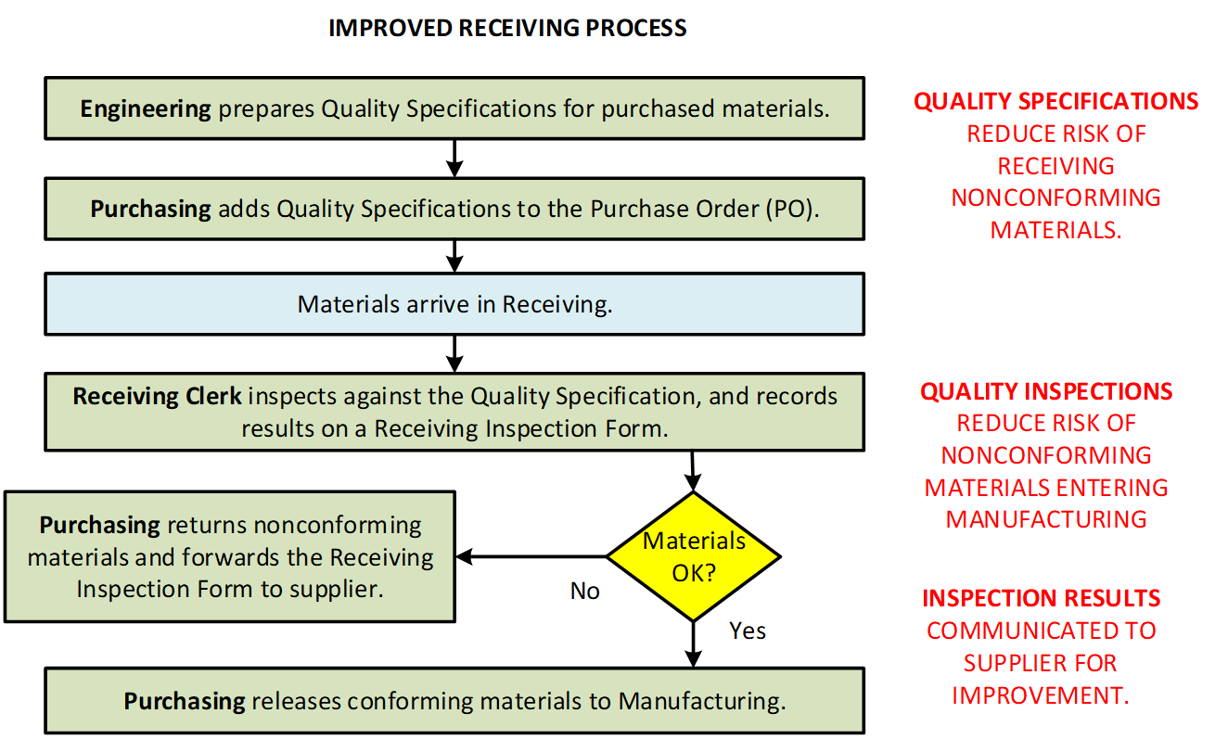
Notes:
Story about the plastic front panels painted black. Insufficient specs. Often, bad quality is the fault of your company, not the supplier.

Slide 22
Finally, the Gap Analysis
Receiving Process was compared to QMS requirements (e.g. ISO 9001)
QMS requirement: The organization shall monitor the performance of its suppliers.
Supplier Monitoring was added to flow chart (red box):

Slide 23
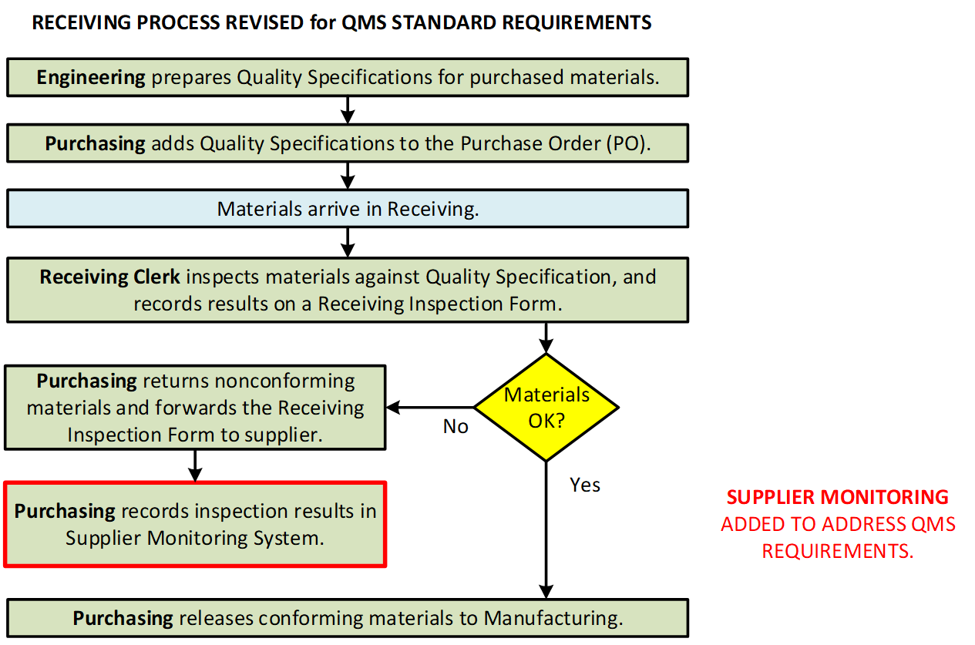

Slide 24
Bonus Tips for developing your QMS
90% of the information that you need to document, is the information you need to do your work.
  We tend to over-document our QMS
  Think of your QMS as a collection of processes, not a collection of procedures
  Use other management tools, such as training, checklists, and software.

Slide 25
Bonus Tips (cont.)
Visit other companies that have made the Quality journey, but…
Avoid copying “ISO procedures” from another company. Your processes are unique to your organization.
Start with basic management tools that you have, such as spread sheets and word processors.
Use the right management tools for the complexity and risk of your processes and products.
If looking for a software solution, flow chart the process first.

Slide 26
This what you learned
How to use the “Bottom-Up” approach
How to use Flow Charts to develop and improve your QMS
How to compare your QMS against QMS requirements

Slide 27


Slide 28
MPQA Quality Alliance Contact Information
MPIA Website
https://www.montanaphotonics.org/
MPIA Quality Alliance
https://www.montanaphotonics.org/quality-alliance/
Trainers | Company | Role | Email
Ben Klein | FLIR Systems Inc. | Quality Manager | benjamin.klein@flir.com
Daniel Juliano | MSU Technology Transfer Office | Director | daniel.juliano@montana.edu
John Malachowski | FLIR Systems Inc. | Manufacturing Manager | john.malachowski@flir.com
Mary Johnson | Wavelength Electronics | CEO | mary@teamwavelength.com
Steve Birrell | Quantum Composers | CEO | sbirrell@quantumcomposers.com
Conlin Ritter | Quantel/Lumibird | Quality Manager | conlin.ritter@gmail.com
Kurt Borge | Quality Time Montana | Quality Consultant | QualityTimeMontana@gmail.com

