Slide 1
Return Material Authorization Process
MPIA Quality Alliance Webinar Series
Presenter: Ben Klein
Notes:
Welcome to webinar number 5 in a series of quality-related webinars presented by the MPIA Quality Alliance; a sub-committee of the Montana Photonics Industry Alliance in Bozeman, Montana. Thank you for joining us.
My name is Ben Klein. I’m the Quality Manager for Teledyne FLIR Surveillance, Inc in Bozeman, Montana
The subject of this webinar is the Return Material Authorization Process.

Slide 2





Agenda: This is what you will learn
What is a Return Material Authorization Process (RMA)?
Why is the Return Material process invaluable to quality (and reputation)?
How is an RMA process implemented? (What can you do right now?)
How does the RMA process lead to improving products and processes?
Fictional Product
Notes:
In this presentation you’ll learn answers to the following questions:
What is a Return Material Authorization Process (RMA)?
Why is the RMA process invaluable to quality (and reputation)?
How is an RMA process implemented? What can you do right now to make this happen?
How does the RMA Process lead to improving your products and processes?

Slide 3



Returned Product Problem Statement
Problem: Product returns are increasing in quantity
Don’t know why they are returning
No idea how many are returning
Takes a long time before sending fixed product back to the customer
Returned products are misplaced or lost
Customers are not happy. Considering another source for products like yours
Solution: Implement a Return Material Process
Notes:
Problem Statement
Problem: Product returns are increasing in quantity.
You don’t know why they are returning in such high quantities.
You have no idea how many are being returned.
You don’t have enough information regarding the reason they are being returned to you. Are these out of box failures that are possible warranty returns or are they products that have been in the field for years?
Takes a long time between receiving the returned product and fixing it and sending it back to the customer.
Returned products is sometimes misplaced or even lost (it can happen!).
Customers are not happy with your products so far and they are considering another source for similar products. They are beginning to lose their trust…
Solution: Implement a Return Material Authorization Process

Slide 4

What is the Return Material Authorization Process?
The Return Material Authorization Process is the process for managing products that customers return for refund, repair, or replacement.
RMA Process
Customer
Service
Repair
Replacement
Upgrade
Calibration
Warranty Evaluation
Warranty
Non-Warranty
Notes:
Gem 1: What is a Return Material Authorization Process
The Return Material Authorization Process is the process for managing products that customers return for refund, repair, or replacement.
This is also known as the Return Merchandise Authorization Process. We’ll refer to it in this presentation as the RMA process.
There are many types of returns. For the purposes of this presentation, we’ll use two categories with the following terms:
Service Returns
Warranty Evaluation Returns
You may choose to use more than two categories or different terms. But we’ve found that keeping it simple like this works pretty well.
Service returns are returned with an RFQ (request for quote) to purchase a type of service: rework, repair, upgrade, calibration.
Warranty Evaluation returns are returned because the customer is not happy with the product because it is nonconforming, damaged, or is not meeting expectations in some manner. You are under a contractual obligation to be sure that your product meets expectations and you essentially sign that agreement when you accept an order. So when you receive an RMA for warranty evaluation, it is vital to take care of these with high priority and to have a good process.
This presentation will focus on warranty evaluations though the overall system we are presenting will work for both.

Slide 5

Why is the Return Material Process Important for Quality and Reputation?
  Reduces risk of losing track of returned product
  Reduces risk of ongoing production of bad product
  Drives product improvement
  Provides insight regarding the quality and reliability of your product
  Provides opportunity to build your relationship with customer
Returns and the way you handle them define your reputation!
Notes:
Gem 2: Why is the RMA process invaluable to product Quality and Reputation
Even if you have the best designed products with the highest quality and reliability, with great processes and well-documented work instructions, highly trained, skillful technicians in manufacturing, sooner or later you will have some of your products returned to you as an RMA for warranty evaluation. So it is critical to have a good process in place in order to manage them effectively and efficiently.
The RMA process is invaluable because of the following:
Reduces risk of losing track of returned product. A good RMA process will track the product from the moment it reaches your door until you ship it back to the customer.
Reduces risk of ongoing production of bad product. The cause of the problem may be systemic and therefore it may be affecting the products in WIP.
It provides feedback information that can drive root cause analysis which leads to product improvement.
Provides insight regarding the quality of your product, that is, how well it meets specification straight out the gate) and the reliability of your product (that is, how well and how long it maintains its initial high quality, how long does it work.
It provides opportunity to build trust in your relationship with customer by providing timely feedback and a positive experience. It gives even greater insight into who you are as an organization.
Moments of truth: When you have an RMA event, you can look at it as a disaster because you failed to meet your customer’s needs, your customer’s expectations and you’re concerned about how this reflects on you and your organization.
Or you can look at it as an opportunity! It’s an opportunity to support your customer to prove how well you service your customers.
To show your customers that your service is as high quality as your products.
To turn a bad situation into one where you have an even better relationship with your customer.
To demonstrate that you are a partner, invested in the shared success of the product.
You get to choose your approach. And the choice you make will have a significant impact toward building trust with your customer or damaging your reputation. It is a moment of truth!
Returns and the way you handle them define your reputation!

Slide 6

Process Implementation (The Solution)
Customer Requests Return Material
Identify, Document, Log RMA
Evaluate Returned Material
Determine Warranty Status
Determine Disposition
Perform Disposition
Ship to Customer
Notes:
Gem 3: Process Implementation
How is an RMA process implemented?
You can implement an RMA process using basic, low-cost tools that are likely already available to you. You don’t need expensive software. While there are many solutions to solve this problem for how to manage RMAs, most of them, you will find, have common approaches and similar steps. The solution provided here is a simple one that captures the essence of what you can expect in any RMA process and will hopefully give you what you’re looking for or at least give you ideas for how to implement a process best suited to your organization.
The overview of this process can be broken down into five primary top-level steps:
Identify and document the RMA
Evaluate the returned products (physically examine them) and review the information provided with them.
Determine warranty status (based on your warranty criteria)
Determine disposition (what are you going to do with it)
Perform disposition so can you ship it back to the customer
We’ll take a closer look at each of the steps in the following slides

Slide 7
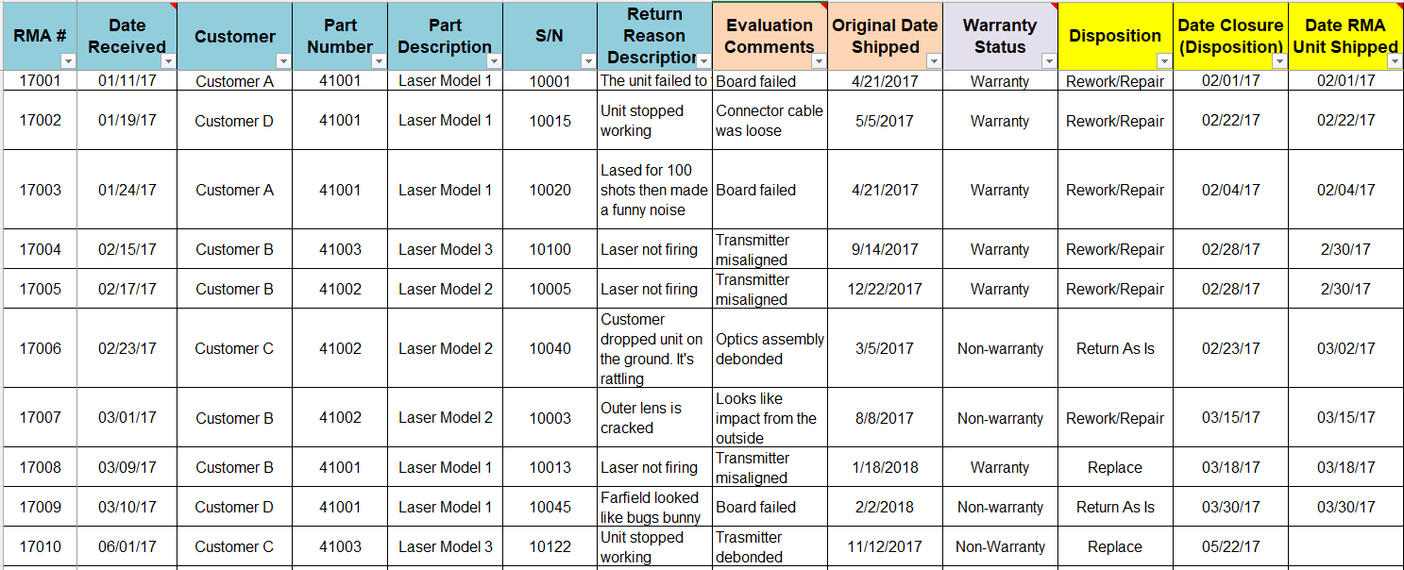
Step 1: Identify, Document, Log RMA
Gather as much information from the customer as you can!
Provide an RMA Number for Tracking
Ensure Returned Material is clearly identified when it returns
  Returned Material Log (Excel log)
Notes:
Step 1: Identify and Document
This step begins when the customer contacts you.
You’ll want to try to gather as much information as you can about why the product failed. You may even want to provide a form to the customer to complete with detailed information. You can call this form an RMA Form or a Service Form. The more information the better. Here is where you begin working with your customer to solve the problem.
The basic information on the form includes customer company name, s/n, part number, date, etc. But the truly valuable information includes anything they can provide regarding the nature of the failure and the conditions in which the failure occurred.
If you decide that it would be best to have the customer return the product to you for more in-depth evaluation, you’ll want to provide an RMA number. This RMA number will be used to identify and track the returned product from the moment it reaches your receiving area until it is shipped back to the customer. The information from the RMA is then logged in a spreadsheet or database. We call this the RMA Log. Each entry is uniquely identified by the RMA#. You’ll see later in this presentation, why capturing and compiling this information can lead to invaluable insight regarding your products.
This log also serves the key function of tracking the product returns throughout the process so it isn’t lost or forgotten. It’s a good idea to have someone in your organization assigned the responsibility of coordinating this process to ensure that this product is properly prioritized and processed effectively. The RMA log serves as a history to see if you’ve received this product or similar products before and what you did to fix it last time.

Slide 8
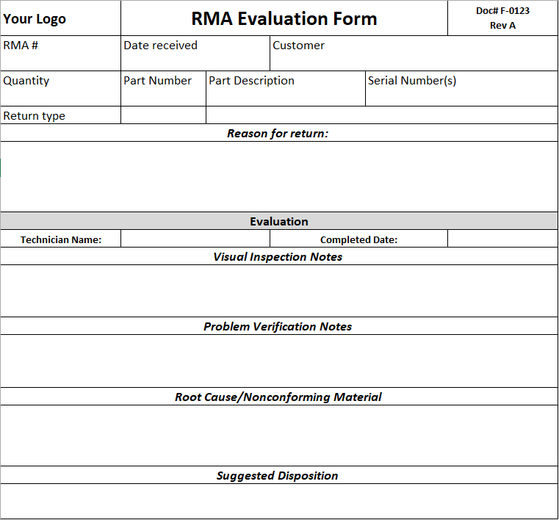


Step 2: Evaluate Returned Material
Visually inspect
Verify customer stated problem
Determine cause
List broken parts
Document instructions for disposition
  RMA Evaluation Form
Notes:
Step 2: Evaluate Returned Material
This step begins after you have physically received the product and have updated the RMA log with information.
Once you receive the returned product you’ll want to following these steps:
Visually inspect the product, touching it as little as possible. This is just an initial assessment to see if has any signs of obvious damage. This is also the opportunity to verify that the part number, serial number, and the quantity matches what the customer said they would return to you.
Verify customer stated problem. Can you reproduce or measure or in any way make the problem occur so you can see what the customer was seeing. Convince yourself that you agree with the stated problem.
Determine cause. Once you have verified the problem, can you determine how the problem occurred. Why did it fail? What part or parts failed? You may want to do a root cause analysis to be sure you understand the cause of the failure particularly for complex systems or if this a systemic issue.
List broken parts. You’ll want to be sure to update the RMA log with a list of which parts failed. This will help you identify trends and possibly to increase your service inventory if you suspect there may be other units in the field that are at risk of failing for the same reason. Plus these are the parts you’ll need in order fix the unit.
Instructions for disposition. Finally, you’ll want to determine what you need to do to remedy the situation and document this as instructions and recommendations.
It is good practice to capture this information on a form such as an RMA Evaluation form. This information is then transferred into the RMA log and is used to determine the warranty status and disposition.

Slide 9
Step 3: Warranty Evaluation (Warranty Criteria)
Determine the Warranty Status based on the Evaluation
No
Within Warranty Period?
Non-warranty
Yes
Causes by customer:
Improper use
Tampering,
Accidental damage
Responsible Party?
Customer
Causes in your control:
Process/Workmanship
Design
Supplier
Other (unusual or uncertain cause)
Your Organization
Warranty
Notes:
Step 3 Determine Warranty Status
Now that you have the information from the evaluations, you can perform the critical step of determining the warranty status: Is it a Warranty or is it Non-Warranty.
Warranty status is determined through a simple flowchart to see whether or not it meets the warranty criteria. This is the make-or-break step of the event as this determines whether you own the problem or whether your customer is responsible.
There are generally two components to the warranty criteria: Warranty Period and Responsible Party. You’ll want to be sure to define this criteria in your terms and conditions document or documented as part of the agreement for the order.
The first question: Is the product within your defined warranty period?
The Warranty Period is the amount of time you establish in which you are liable for repair, or replacement if the product turns out to be defective.
This is generally the linear time from date shipped to the date the product fails. For example, you might establish warranty period of 12 months. But it could also be time in use based on an internal timer of the product, number of times used or whatever you decide.
If the answer to that question is no, then the warranty status is Non-Warranty.
If the answer to the question is yes, meaning it is still within your established warranty period, then you move onto the second question/criteria.
The second question: Who is the responsible party?
The question is about trying to determine who the Responsible Party is based on what you determined was the cause of the failure. To answer this second question, you have to review the information provided from the customer and information from the in-house evaluation.
If the cause of the failure was something the customer clearly did (they damaged it through misuse, tampering, or accident) it is Non-Warranty.
However, if you determine that the cause of the failed product is something within your control, then it is a warranty. Things in your control include your design, your process or workmanship, your suppliers. In some cases, you may not be able to figure out what the cause is, so you’ll probably have to accept it as a warranty.

Slide 10

Step 4: Determine Disposition
Work with customer to come to agreement on disposition.
Rework/Repair
Replace
Return to Customer as is
Develop customer relationship
Notes:
Step 4: Determine Disposition
Now that you’ve determined the warranty status, you will want to provide the findings to your customer and work with them to determine what you want to do with the product.
If it’s a non-warranty, you’ll want to provide a quote for repair or replacement.
Or you may choose to repair or replace it at no cost to your customer, pro bono, as a good will gesture based on your relationship and the possibility of future orders and opportunities.
It’s important to remember that Warranty is not only about who pays, it’s about the contractual obligation defined in the terms and conditions. So fixing it under good will does not mean warranty.
If it is warranty you’ll explain what you’d like to do to fix the product (or replace it) and make sure they understand that it is going to be fixed or replaced under warranty.

Slide 11

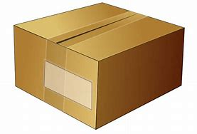
Step 5: Perform Disposition, Ship Back to Customer
Nonconformance report,
Failure Analysis
Cost of Poor Quality
At this point, the service you provide to your customer IS the product.
Recognize that, regardless of who pays, effort was spent, and costs were created.
It is up to you to create the value to the customer and to your organization with each one of these events.
Notes:
Step 5: Perform this Disposition and ship back to customer
Once you determine what you want to do with the product, then perform the disposition and ship it back to your customer.
At this point, the service you provide to your customer is the product.
Recognize that, regardless of who pays, effort was spent, and costs were incurred. This is often referred to as the cost of poor quality
It is up to you to create the value to the customer and to your organization with each one of these events.

Slide 12
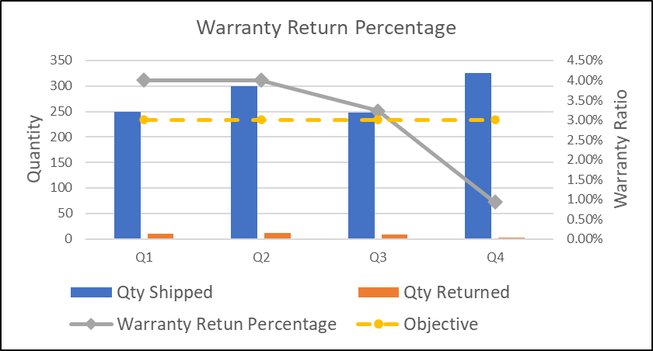

Improvement Through Data: Warranty Return Ratio
$$Warranty Return Ratio=\frac{Qty Warranty}{Qty Shipped}$$
Expressed as a percentage
Measured over time (e.g. total qty in past 12 months)
Expressed in unit time (monthly/quarterly)
Only includes RMAs returned for Warranty Evaluation
Improvement
Process, Design, Supplier
Root Cause Analysis
Commonly used as a Quality Objective
Notes:
Gem 5: Improvement Through Data
Finally, the RMA process is invaluable to quality because it can help you improve your system.
Because you’ve logged the RMA events in your RMA log, the information can be compiled as data and analyzed for patterns and trends.
Warranty Return Ratio
The first thing you’ll want to calculate is the warranty return ratio. The warranty return ratio is the quantity of warranty returns (returned products that you’ve determined meets the warranty criteria) divided by the quantity of products you shipped.
This is expressed as a percentage and is calculated over an established period of time. It’s common to use a rolling annual if your warranty period is 12 months. This means that you’re measuring your ratio base on the quantity of returns and qty shipped within the past 12 months.
You’ll want to plot this either monthly or quarterly. (This only counts Warranty evaluations, of course)
In formal Quality Management Systems, this is commonly used as a Quality Objective to assess how well your organization is performing and how well you are meeting customer needs.
You can also analyze the data for trends with specific products to identify which products are failing the most. Pareto charts are an excellent tools for determining this. You might even consider doing a warranty return ratio by product line or model.
You’ll want to perform root cause analysis on trends with this data to further understand what the root cause of failure is. This will lead you to solutions that help you improve your system in three primary areas.
Process
Design
Supplier
Processes: If the cause of the problem is your process, then you’ll want to refine your processes, your fixtures, your tools. This event might be an event an opportunity to improve the skills and knowledge or your personnel.
Design: If the cause of the problem is the design, you can work with engineering to improve the design to make it more reliable. It will also let you know that you may have to be prepared to implement these changes for your other products already in the field in case they are returned to you. This can provide invaluable lessons learned for future product designs.
Supplier: If you determine the cause of the problem is the responsibility of the supplier, you can begin working with the supplier so they can improve their processes.

Slide 13
Summary:
This is what you learned about the RMA Process
The RMA process is a solution for managing product returns effectively and efficiently.
The RMA process provides an opportunity to build trust with your customers.
The RMA process can easily be implemented in your organization using basic low-cost tools and a few basic steps.
The RMA process provides data that helps you improve your products and your processes.
Notes:
Summary
Gem 1: The Return Material Authorization Process (RMA) is the process for managing products returned by your customer for rework, repair or replacement.
Gem 2: The RMA process provides an opportunity to build trust with your customers and establish a reputation.
Gem 3: The RMA process can easily be implemented in your organization using basic low-cost tools and a series of simple steps.
Gem 4: The RMA process provides data that can be used to improve your products and your processes.
Implement this process in your system and help your organization take another step on the path of success!
For more information about this process, example templates, tools and ideas, please visit our website at https://www.montanaphotonics.org/
Thank you so much for your time.

Slide 14
Contact Information, Tools, Resources
MPIA Website
https://www.montanaphotonics.org/
MPIA Quality Alliance
https://www.montanaphotonics.org/quality-alliance/
Trainers | Company | Role | Email
Ben Klein | Teledyne FLIR Systems Inc. | Quality Manager | benjamin.klein@teledyneflir.com
Daniel Juliano | MSU Technology Transfer Office | Director | daniel.juliano@montana.edu
Mary Johnson | Wavelength Electronics | CEO | mary@teamwavelength.com
Steve Birrell | Quantum Composers | CEO | sbirrell@quantumcomposers.com
Conlin Ritter | Quantel/Lumibird | Quality Manager | conlin.ritter@gmail.com
Kurt Borge | Quality Time Montana | Quality Consultant | qtm@q.com
Matt McCune | Autopilot Inc. | President | matt@autopilotdesign.com

Slide 15
Reference Information
Term | Definition
RMA | Returned Material Authorization or Returned Merchandise Authorization is the process where a customer may return a product within a given period (warranty period) for possible refund, replacement, repair.
RMA Number | The RMA number provides the customer the authorization to return product to the supplier and is used to track the product through RMA process.
RMA Log | A spreadsheet or database for capturing information regarding the RMA event, compiling information for data analysis, and tracking it to closure.
MRB | Material Review Board. A team of people, generally subject matter experts, authorized to determine disposition of discrepant material.
Rework | Action on a nonconforming product to make it conform to the requirements. (ISO 9000:2015 3.12.8)
Repair | Action on a nonconforming product to make it acceptable for the intended use. (ISO 9000:2015 3.12.9)
Scrap | Action on a nonconforming product to preclude its originally intended use. (ISO 9000:2015 3.12.10)
Nonconforming | Does not meet specification as defined by a drawing
Service Return | Returned specifically for rework, repair, upgrade, calibration and are generally sent with an RFQ. It is a known problem
Warranty Evaluation | Returned for warranty because the customer is not happy with the product because it is nonconforming or nomeeting expectations.

