Slide 1
Document Control
MPIA Quality Alliance Webinar Series
Presenter: Ben Klein
Quality Manager
Teledyne FLIR Surveillance, Inc. Bozeman, MT
Notes:
Hello! Welcome to the MPIA Quality Alliance webinar series. The MPIA Quality Alliance is a sub-committee of the Montana Photonics Industry Alliance in Bozeman, Montana. Our mission is to provide helpful tools for implementing Quality Management Systems. This presentation is one of series of recorded presentations and webinars designed to assist organization with implementing processes as solution to common manufacturing problems.
My name is Ben Klein. I’m the Quality Manager for Teledyne FLIR Surveillance, Inc in Bozeman, Montana and the Chair of the MPIA Quality Alliance.
This presentation provides a framework for implementing a Document Control Process in your organization.
The Document Control Process is an essential solution for ensuring you capture and organize organizational knowledge.

Slide 2




Agenda: This is what you will learn
What is a Document Control Process?
Why implement a Document Control Process?
How do I implement a Document Control Process?
How does a Document Control Process improve the organization?
Notes:
In this presentation you’ll learn
What a Document Control Process is
Why it is so valuable to implement a Document Control Process
A few easy steps for how to implement this process in your organization.
How the Document Control Process leads to improving your organization (Learning organization)

Slide 3

Problem Statement
Problem: Orders are coming in! But production can’t keep up, wasting time and money!
Technicians are spending hours searching for drawings and work instructions!
Buyer bought a thousand key parts…but none of them work…sent an obsolete drawing to supplier
The lead technician is retiring…and is the only one who knows how to operate the machines
Yields are tanking because assemblies are built wrong and each one is different.
One of the most important drawings is missing!
Solution: Implement a Document Control Process
Notes:
We’ll begin with a problem statement and then demonstrate how these problems are solved by the Document Control Process
Common problems that organizations run into when there is no document control process:
Orders are coming in and the opportunity for growth and success as finally arrived! But production can’t keep up with demand
You’re wasting time and money on errors and inconsistencies. Personnel are spending hours searching for key drawings and work instructions. When they could be building products
Buyers keep buying the wrong parts, that don’t work. They are sending obsolete drawings to their suppliers.
A senior member of the team, the lead technician who’s been with the organization since it began, is retiring! He’s the only one who knows how to operate and maintain the machines and has been building the product since its first prototype. He knows the processes like the back of his hand. None of his processes are written down.
The customer is waiting for a quote, but you can’t find the latest revision of the most important drawing.

Slide 4

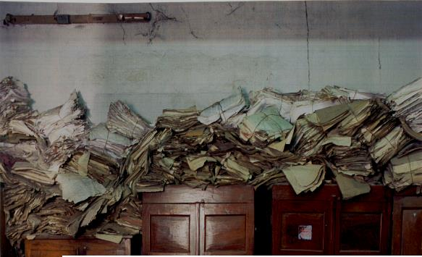

What is a Document Control Process?
The Document Control Process is a mechanism for organizing, storing, and distributing documents such as procedures, work instructions, forms, and drawings.
Organize
It’s got to be here somewhere!?
Information you need when you need it!
Notes:
The Document Control Process is a mechanism for organizing, storing, and distributing documents such as procedures, work instructions, forms, and drawings.
It is a critical process to organizing your organization.
The key to success for any organization is being really good at managing the thousands of details. The Document Control Process is one of the tools for managing the details regarding documented information.

Slide 5

Why Implement A Document Control Process?
Risk Mitigation:
Prevents the risk of using the wrong revisions by ensuring only the current revisions are available
Prevents the risk of losing your organizational knowledge, information, data.
Captures Organizational knowledge:
How you designed your product.
How you build product
How you purchase materials, control documents, calibrate your equipment, train your personnel.
Document Availability:
Ensures the organizational knowledge is easily accessible to those who need it.
Ensures procedures and work instructions are available at points of use.
Ensures your buyers are buying the right revision of materials.
Ensures your forms are easily available to capture information.
Notes:
Risk mitigation is one of the most important aspects that a document control process serves. It prevents the risk of losing your organizational knowledge.
Your organizational knowledge is your best know practice for how you design your products, how you build your productions how you purchase your materials. If you document your processes in the form of documented procedures then you’ll want to organize the procedures so you don’t lose them and so they are available to everyone in the organization.
Having your procedures, work instructions, forms, drawings, software available to your personnel is one of the key ways to ensure you knowledge is shared. This ensures everyone is performing the same process, has access to the same documents, can purchase the right parts, can build your products the right way, the same way, each time.

Slide 6
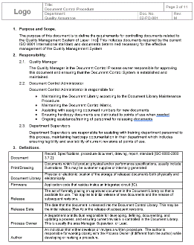
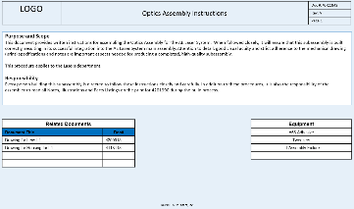
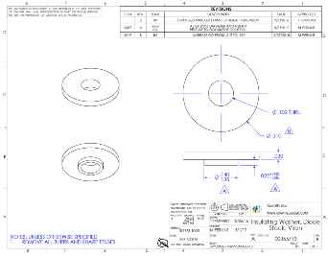
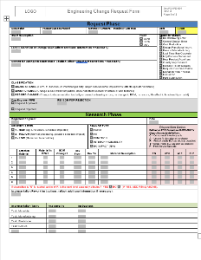
Document Control Application
QMS Procedures
Product-Related Work Instructions
Design Drawings
Forms
Controlled as hardcopies and/or electronic copies.
Notes:
You’ll use this process to control your QMS Procedures such as:
Quality Manual
your procedure for Document Control, Calibration, Purchasing, etc.
Product-related Work instructions, which describe how to build your product
Design Drawings that define the specifications and requirements for your products
The forms you use to capture information and data that you’ll store as quality records.
You can control these as hardcopies, electronic copies or both. Controlling electronic copies is typically much easier than hardcopies especially if you have all of your electronic copies in a single, centralized folder accessible by everyone in your organization. Controlling hardcopies can be tricky because they have a tendency to wander. So if you control hardcopies, you will want to be sure they are in binder clearly identified as controlled hardcopies and/or you’ll want to mark the documents in such a way that indicates that they are controlled.
You can also use this to control versions of software and firmware.

Slide 7

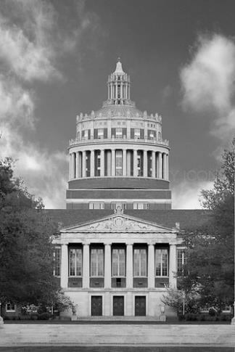
How To Implement A Doc Control Process
Create a Document Library
Create Document Templates
Determine a Document Numbering System
Assign a Document Control Administrator
Determine an Approval Process
Manage Changes
A library stores your reference materials for use.
Notes:
How do you implement a Document Control Process
Here are six elements that are common to document control processes. The slides that follow captures each step.
These steps are easy to implement and don’t require fancy and often expensive software or apps. They can be implemented using basic tools that are likely already at your disposal.
Create a document library that store your documents
Create a document template so that your documents have a common and familiar appearance and contain the key elements of a document
Determine a document numbering system that provides a unique identifier. There are many ways to approach document numbering.
Assign a Document Control Administrator. This person is responsible for coordinating the document control process and maintaining the library
Determine an approval process – this defines who is authorized to approve and the mechanism for approval
Determine a process for managing changes to these documents which may include validating the change prior to implementation.

Slide 8
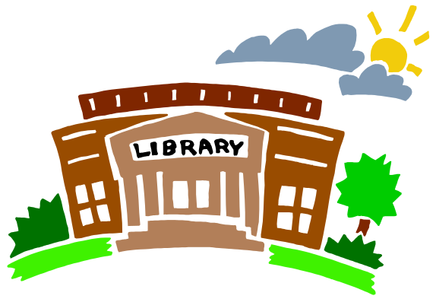
Create a Document Library
Document
Library
Create a Folder called the “Document Library”
Current
Revisions
Create a sub-folder called “Current Revisions”
  Store only current revision of your documents in this folder
  This where everyone goes to get the current revisions of document
Document
Archive
Create a sub-folder called “Document Archive”.
  Store obsolete revisions in the document for future reference
Notes:
Create a folder called the Document Library. The term “library” is used to invoke the location where you store knowledge and provides a common location where people can go to access this knowledge.
In the Document Library, create two folders: Current Revisions and an Archive Folder.
Current Revisions
This is where only the current revision of your document reside.
This ensures that everyone is using only the current revisions.
Everyone goes here to retrieve the current revision of the document they need.
This is where you are capturing your current best practices, best designs as of now, best methods, until better ideas and designs can replace them.
Document Archive
This is where you store the obsolete revisions of documents. Once a document becomes obsolete, that is, replaced by an improved version, it gets stored in the archive folder and essentially becomes a history record.
No one should pull documents from here unless it is part of an inquiry, root cause analysis or some other purpose for understanding the history and evolution of the process.

Slide 9
Place Document Library in Accessible, Protected Location
Centralize
Place Document Library in a centralized location.
Secure
Make sure the Doc Library location is cyber-secure.
Document Library
Technicians
Buyers
Authors of next revisions
Trainers
Protect
Make documents read-only.
System Back-Ups
Link
Encourage personnel to create a links to Document Library.
Notes:
Centralize
Place the document library in a centralized location where everyone can have access to it.
This is best done on some kind of network.
Generally, you’ll want to have this folder high up in your folder structure so it is easy to locate
Secure
Make sure the library/network is cyber secure. This Library holds your intellectual property. So, you’ll want to safe-guard it to ensure unauthorized people can’t get access to your proprietary information.
This is also critically important if your information is export controlled.
Link
It’s a good idea to ensure that everyone in your organization has a link to the document library on their respective computers. Again, you want to make it as easy as possible for personnel to gain access to your Document Library.
Protect
Make sure that the documents are read-only except for a few select people in your organization. You want to reduce the risk of someone accidentally changing a document in the current revisions. Or prevent someone with good intentions who wants to make a change but without knowing the full impact or risks involved with making an unauthorized change.
The Document Control Administrator is one of the very few who should have read/write access to the document in the Document Library.
You’ll also want to have regular system back-ups of your server or files.

Slide 10
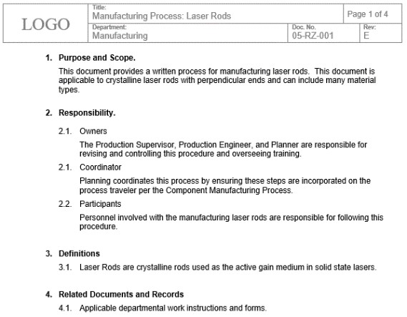
Create Document Templates
Logo
Title
Document Number
Unique identification in header
Revision Level
Department/Area
Include doc number, title, and revision level in filename.
Example:
05-RZ-001_ManufacturingProcessLaserRods_RevE
Notes:
Document Template
It’s a good idea to create a document template that everyone uses when creating a document in your system.
This ensures a common appearance and that key elements of doc control are not missed.
Unique Identity
One of the most important aspects of a document is it’s unique identity. This generally consists of the logo, title, doc number, and revisions level. You might even include the department that the document belongs to.
When you save the document electronically, you’ll want to include the unique identity in the filename, such as doc number, title, and revisions level so that they are easy to organize and locate in your library.

Slide 11
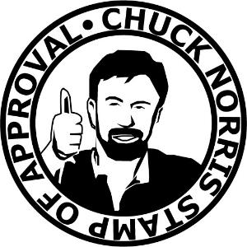
Who Approves?
Author for the document
Process owner or lead responsible for the successful output
  If process affects more than one department each department lead approves
Subject matter expert (such as an engineer)
  Someone who can assess the risk of the change.
Document Control Administrator
  Ensures consistent document formatting rules.
  TIP: You may have it reviewed by several people. Not everyone who reviews it is required to formally approve it.
Notes:
So who approves the documents.
Generally, you’ll want the following people to approve the document:
The author of the document approves to indicate that they authored this revision. You may have more than one author and you may choose to have them all sign or have just one representative sign for them all
The process owner signs. The process owner is the person who is ultimately responsible for the successful output of the process, for example, the department manager or supervisor. If the process affects more than one department, such as a high-level procedure, you may want each of the process owners to sign for approval. When you have multiple owners signing, you gain buy-in to the process and the signed doc becomes an agreement for how you want to conduct your business processes.
You may want a Subject Matter Expert approve the document if the process owner isn’t the SME. This might be an engineer, for example, who helped design the product who can assist with assessing the risk of the process to product quality and reliability
Finally, you’ll want the Document Control Administrator to sign. That person is not approving the content but is instead reviewing and approving the basic formatting of the document to ensure it meets the current formatting rules of your organization.
TIP: It’s a good idea to keep the list of approvers fairly short as the approval process can be lengthy and inefficient if it requires too many approvals.

Slide 12
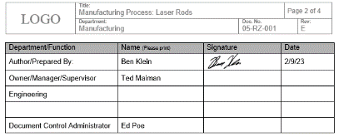
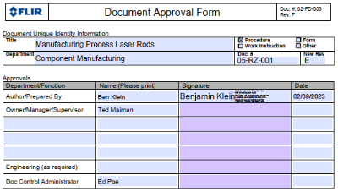
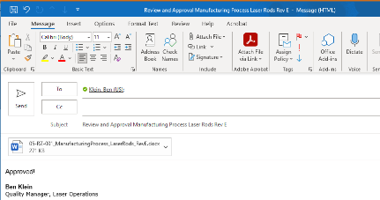
Determine Approval Mechanism
TOC
Approval directly on the document
Approval on a separate form
Approval through an email chain
Logo
Handwritten signatures on the document
Adobe sign on PDFs
States Approval
Retain Record of Approval
Notes:
There are different mechanisms you can choose to determine how you are going to formally approve your documents to authorize them to be placed in the Current Revisions of your Document Library.
You could have handwritten signatures directly on the document itself.
You could have handwritten signatures on a separate hardcopy document approval form that identifies the document you are approving.
You could have a PDF that captures electronic signatures with a click of a button that imbeds information that comes from specific log-in information.
You could even have approvals simply through emails where you send the document to your approvers who simply respond to the email as “Approved”.
However you decide to do it, you’ll want to retain record of the approval for future reference as necessary.

Slide 13
Document Management Process
Change Control Process
Authorize
Should the revision even be made?
Will revision resolve the issue? Will revision introduce risk? Are there other related controlled items that will need revision (Work Instructions, Quality Control forms, etc.)
Validate
Revise
Revise document. (Continual Improvement)
Approve
Submit revision for review from representatives of all impacted parties. (Customer Service, Production, Purchasing, etc.)
Store in Library
Store new revision in Document Library
Archive old revision
Distribute
Notify relevant personnel that document is released.
Perform training
Notes:
First you want to authorize the document to be written or revised. The process owner is generally the one who authorizes the creation of the document.
You may want to test the process as written to validate that it will lead to a successful outcome particularly if the document describes how to build your product.
Now write the document (if it’s a new process), or revise the document (if it’s a process that you’re improving).
Submit the document for review and approval to the interested parties through the approval process we just described.
Store the documents in the Current Revisions folder of your document library.
Finally, notify the key personnel approve or use this document that the document has been released in the document library and is available and use. This can also serve as a signal to train personnel to the current revision of the document.
Note: Some companies will change PN for any change to form, fit, or function; others will only change the Rev. Do at least one of these things!

Slide 14
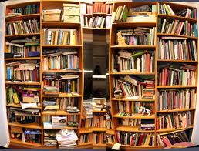
Document Library Process
Document
Library
Rev B
New improved version
Pull Rev A from the doc library and save it with a new rev letter.
Revise the document
Forward it to the document library
Rev A
Current
Revisions
Rev A
Old and obsolete version
Move the previous revision of the document into the Document Archive folder (archived) .
Document Archive
Notes:
It’s a good idea to identify someone in the organization to serve as the Document Control Administrator (DCA).
The Document Library Process is coordinated by your DCA.
This person generally is one of the only people in your organization who has read/write access to the documents in the Document Library folder.
The DCA is the person who maintains the library, ensuring only current revisions are in the Current Revisions folder and that obsolete versions are stored in the Archive folder.
When a new revision of a document is completed and formally approved, the DCA places it in the current revisions folder of your document library.
If the document is a new revision of document already in the library, then the DCA pull the obsolete revision out of the current revisions and place it in the archive folder.

Slide 15

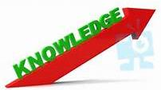


How does a Document Control Process improve the organization?
Ensures consistency in process and product quality
Captures and protects organizational knowledge
Can be implemented with basic low-cost tools
Improves efficiency of information flow
Helps an organization evolve
Become a learning organization!
Notes:
The Document Control Process is key to your success as an organization.
It ensures that you have a defined processes to help make consistent outputs regardless of who performing the process. This is critical building high quality products in a production environment when you may have several people building several products.
It captures and protects the essential knowledge of your organization for how you run your key business processes, how you designed your product, and how you build your products.
It improves the efficiency of communicating organization knowledge by making it easily available to interested parties. It is also very useful in increasing the learning curve when training personnel.
Ultimately it helps your organization evolve because it serves as the basis for improvement and methodically captures changes and improvements. This is the essence of continual improvement and is the foundation of becoming a learning organization.

Slide 16
Summary: This is what you learned
Organize: The Document Control Process is a mechanism for organizing and storing your current revisions of documents such as procedures, work instructions, forms, and drawings.
Organizational Knowledge: A Document Control Process ensures you maintain and grow your organization’s knowledge.
Basic Tools: A Document Control Process is easy to implement with basic tools and simple software.
Evolve: A Document Control Process helps your organization continually improve.
The right people get the right information!
Notes:
This is what you learned today.
You learned that
The Document Control process is simply a mechanism for organizing your organization by storing the current revisions of you documents
The Document Control Process ensures that you capture and protect the essential knowledge of your organization so that it can be shared.
A Document Control process can be implemented in a low-cast manner with tools
Sharing and controlling documents that capture organizational knowledge leads to important improvements that drive evolution and innovation.
Implement this process in your system and help your organization take another step on the path of success!

Slide 17
Contact Information
MPIA Website
https://www.montanaphotonics.org/
MPIA Quality Alliance
https://www.montanaphotonics.org/quality-alliance/
Trainers | Company | Role | Email
Ben Klein | Teledyne FLIR Systems Inc. | Quality Manager | ben.klein@teledyne.com
Daniel Juliano | MSU Technology Transfer Office | Director | daniel.juliano@montana.edu
Mary Johnson | Wavelength Electronics | CEO | mary@teamwavelength.com
Steve Birrell | Quantum Composers | CEO | sbirrell@quantumcomposers.com
Conlin Ritter | Quantel/Lumibird | Quality Manager | conlin.ritter@gmail.com
Kurt Borge | Quality Time Montana | Quality Consultant | kborge1952@gmail.com
Sara Mines | Teledyne FLIR Systems Inc. | Compliance Manager | Sara.mines@teledyne.com
Notes:
I hope you’ve found this presentation useful and that it provides a helpful framework for implementing a Document Control Process in your organization.
For more information about this process and other processes, access to example templates, tools and ideas, please visit our website at www. Montana photonics. Org
You are welcome to reach out to any of the members of the MPIA Quality Alliance for additional questions.
Thank you!

