Slide 1
Root Cause and Corrective Action (RCCA)
Daniel Juliano, Ph.D.
Associate Director for Technology Licensing
MSU TechLink

Slide 2
My Background
Ph.D. Physics at University of Illinois
16 years in Silicon Valley as engineer and manager/director of teams
  Product development & technology development
  Pilot manufacturing

Slide 3
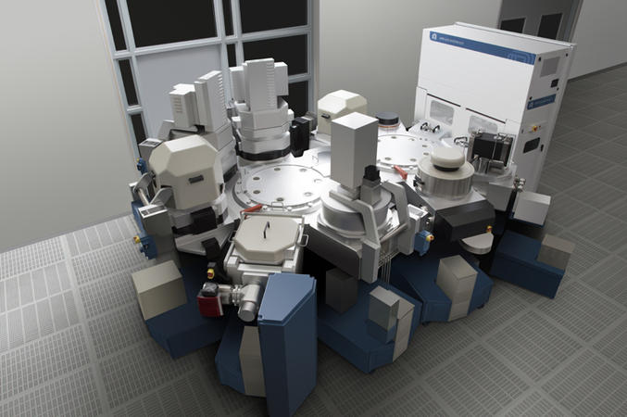
Semiconductor Capital Equipment
Applied Materials, Novellus Systems (now part of Lam Research)

Slide 4
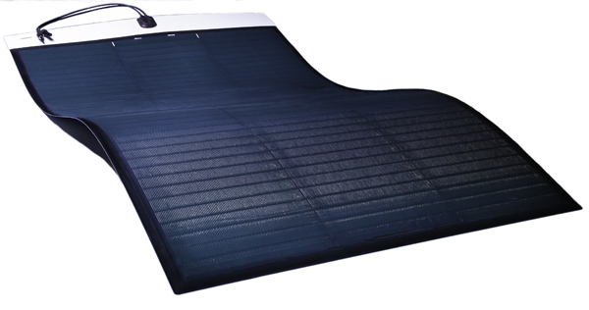
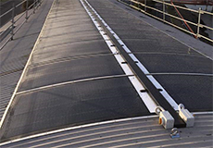
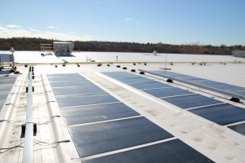
Lightweight, Flexible Solar
Miasolé

Slide 5
My Background
Ph.D. Physics at University of Illinois
16 years in Silicon Valley as engineer and manager/director of teams
  Product development & technology development
  Pilot manufacturing
In July 2016, joined MSU TechLink, managing technology transfer function

Slide 6
RCCA #
Title:
Owner:
Notes:
Owner is key for accountability

Slide 7
Executive Summary
Problem Statement
What was the impact and why do we care about it?
Current Status
Notes:
Problem Statement is key. Easy to go wrong here. Don’t express problem in terms of the solution.
PREVIOUS TRAINING SEMINAR ON WRITING GOOD PROBLEM STATEMENTS.
The question helps keep people on track with the Problem Statement.
With Current Status, serves as a 1 page summary of the issue.

Slide 8
Containment
What was the Containment?
What are the risks associated with the Containment?
How do we monitor the situation before implementation of the Corrective Action?
Notes:
Containment is a Band-Aid. Organizations tend to put in place a containment and then forget about the problem, which doesn’t really solve anything. Also big risks of causing new issues or having the containment fail. Questions on this slide keep you on track. Narrative format of the questions helps step the team through the process, together.

Slide 9
Root Cause
What was the Root Cause?
Why should we believe it was the Root Cause?
Notes:
This is the core of the process, and where most of the work will be done. Can and should use tools such as Pareto Charts, Fishbone Diagram, 5 Why’s to find root cause. Need to address the root cause in order to systematically fix the problem and prevent recurrence. (Hint: root cause is almost never “operator error” or similar blame that can be placed on a person. Instead look at procedures, policies, practices, equipment, training, and the like which can be changed to systematically address the problem.)

Slide 10
Corrective Action
What was the Corrective Action
Why should we believe the same problem will not occur again?
Notes:
Second question 🡪 gets to what is sometimes called the Preventative Action. What can we do proactively to avoid a repeat? Net result is that every RCCA completed makes the organization stronger, more capable, more robust. It’s a mechanism of continuous improvement for the organization.

Slide 11
Action List
Owner | Description | Due Date | Status
Notes:
This action list is likely to be a subset of a larger list kept in Excel format.

Slide 12
RCCA Signoff
Name | Position | Approval Signature | Date
 | Technology Manager
 | Engineering Manager
 | Production Manager
 | Quality Manager
 | Etc.
Notes:
Each company will want to customize the signoff list, which should be as short as is prudent. After completion, the RCCA should be archived, along with the associated data and other project files.

